Slide 1
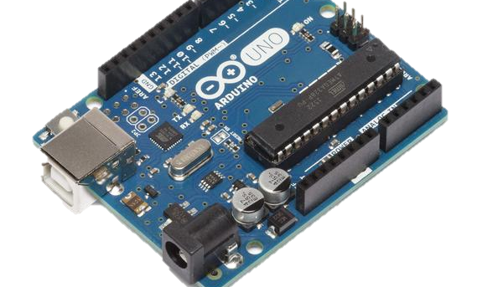
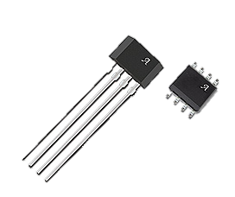
Digital Bike Speedometer
Daniel Collins, 20076240

Slide 2
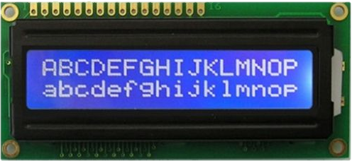
What Does it Do?
As the title suggests, it’s a speedometer for a bike!
It is made using the following components;
LCD Display
Arduino Uno
Hall Effect Sensor
Arduino Coding Application
Wires (Lots of wires)

Slide 3
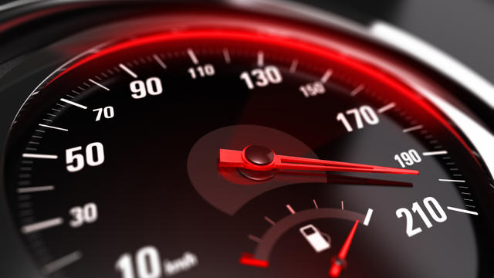
Where did I get the Idea?
Practicality
Interesting
Challenging
Started with a Car now we’re here!

Slide 4
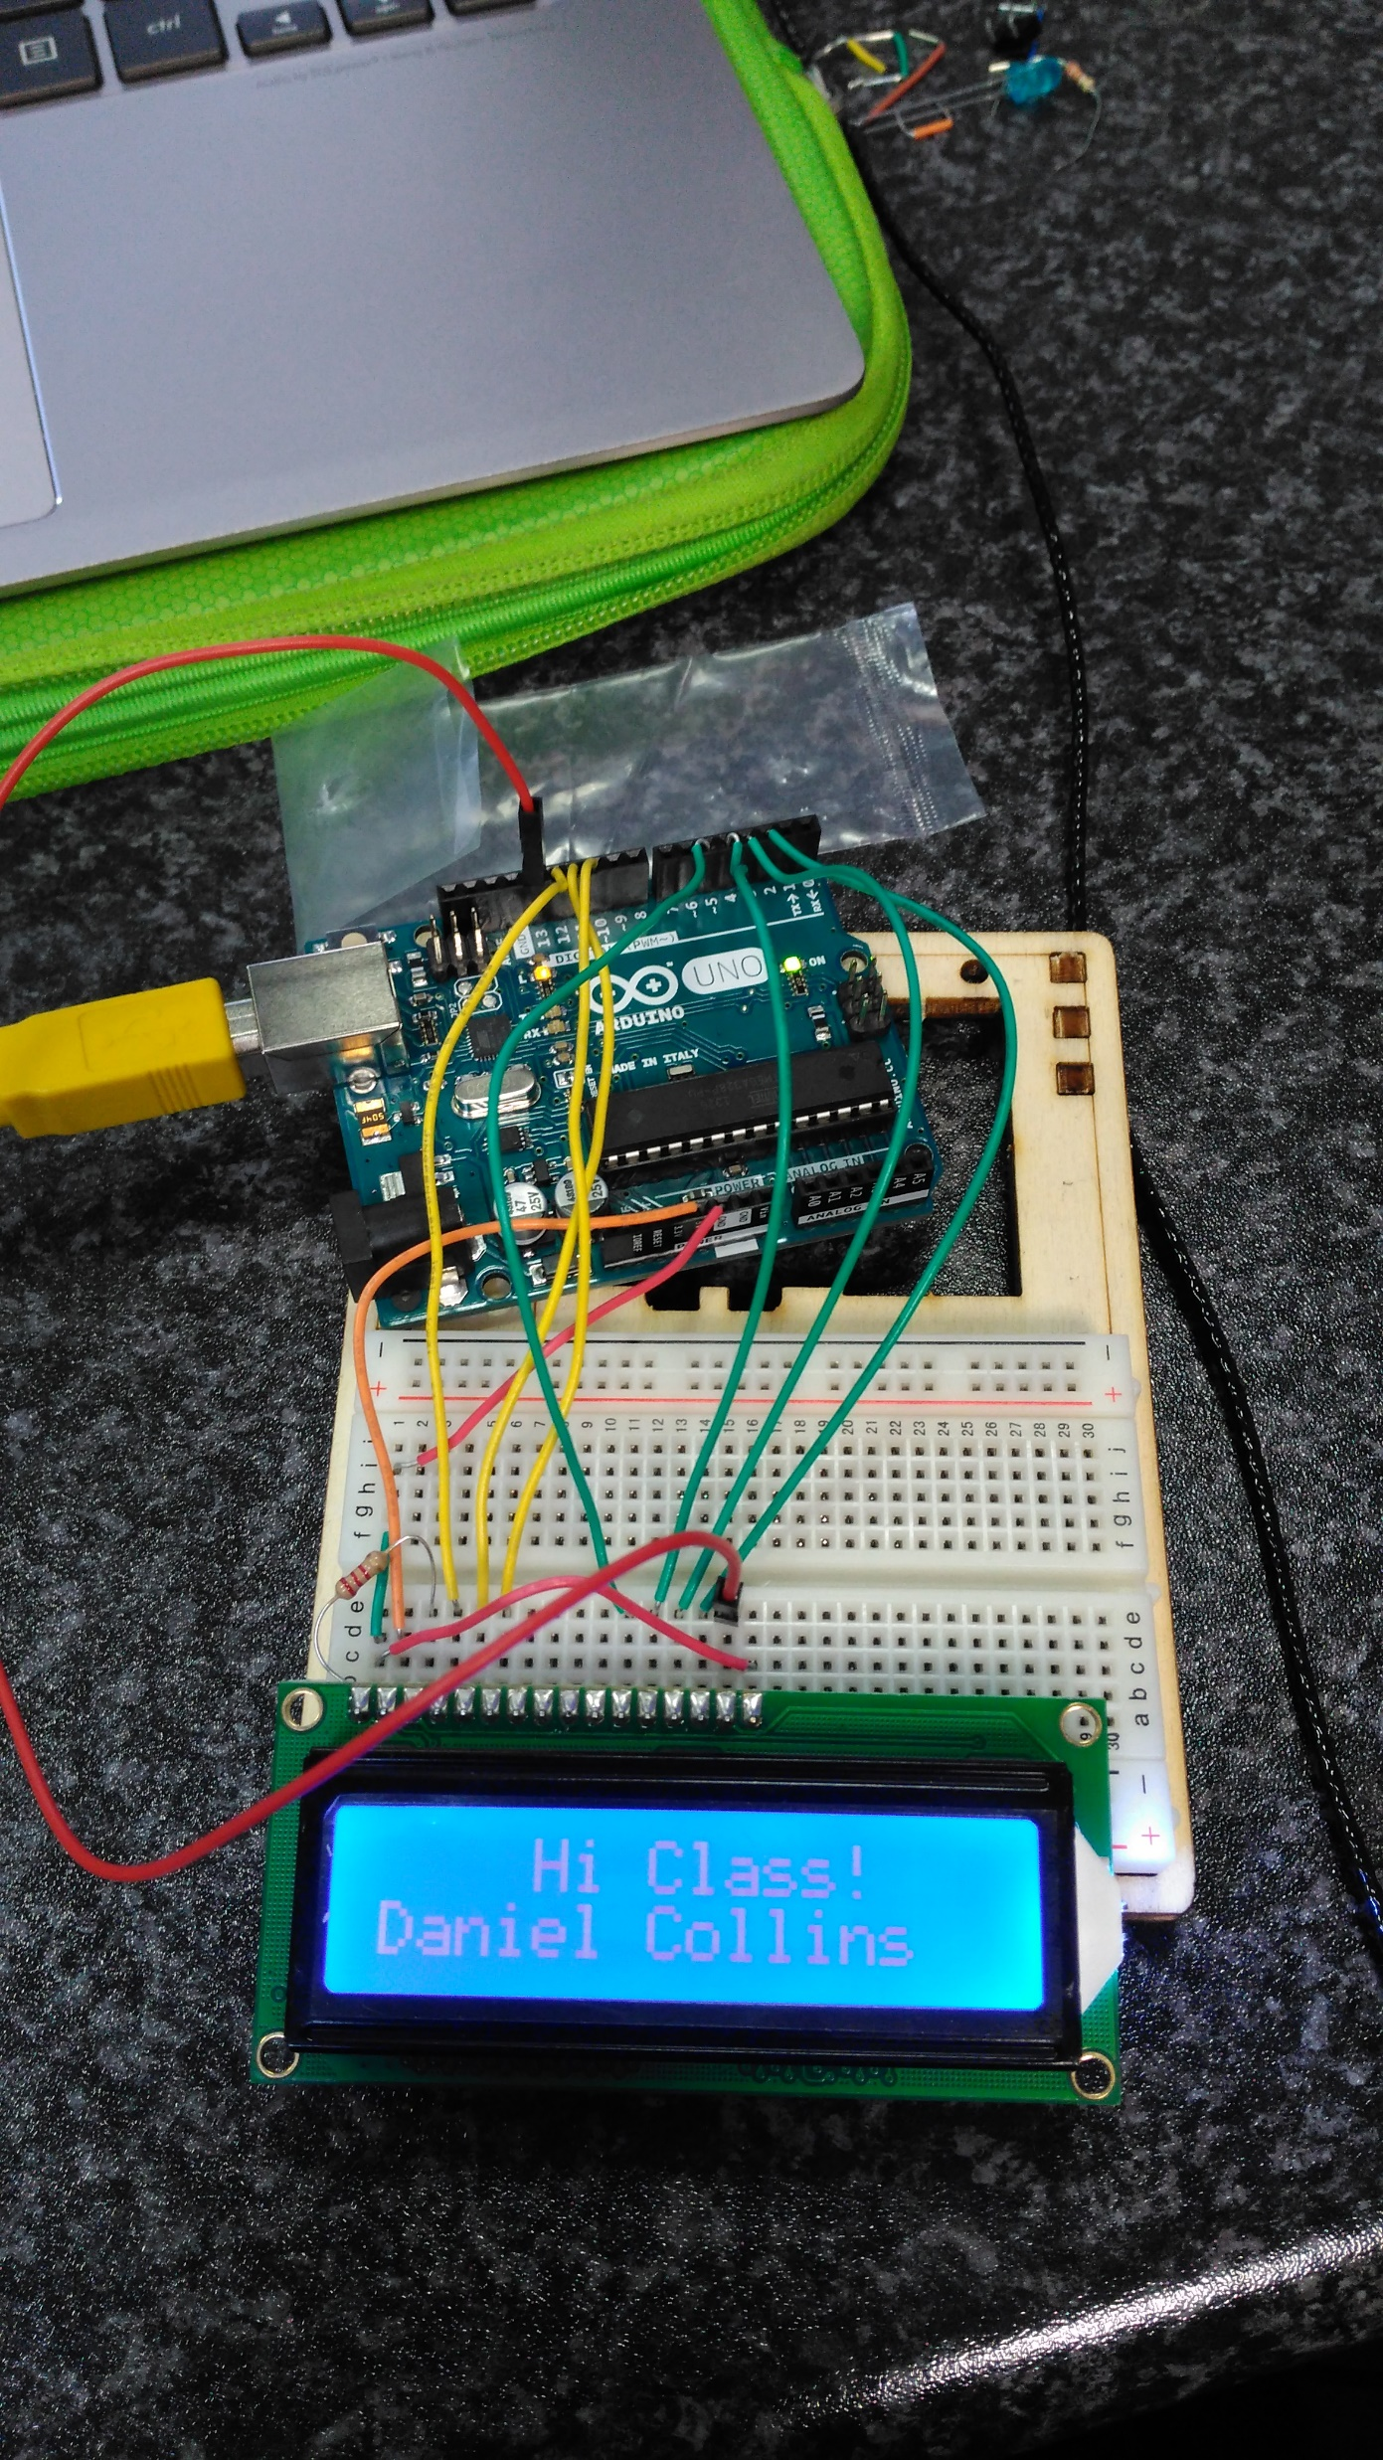
Progress so Far
Started with wrong idea
Tried incorporating Phone Sensors
Settled on Bike Speedometer
Required equipment procured
LCD Display Working

Slide 5

What Needs to Be Done?
Hall Effect Sensor to be incorporated
Function to get Speed using diameter
Put on a Bike
Distance?
Casing?

Slide 6
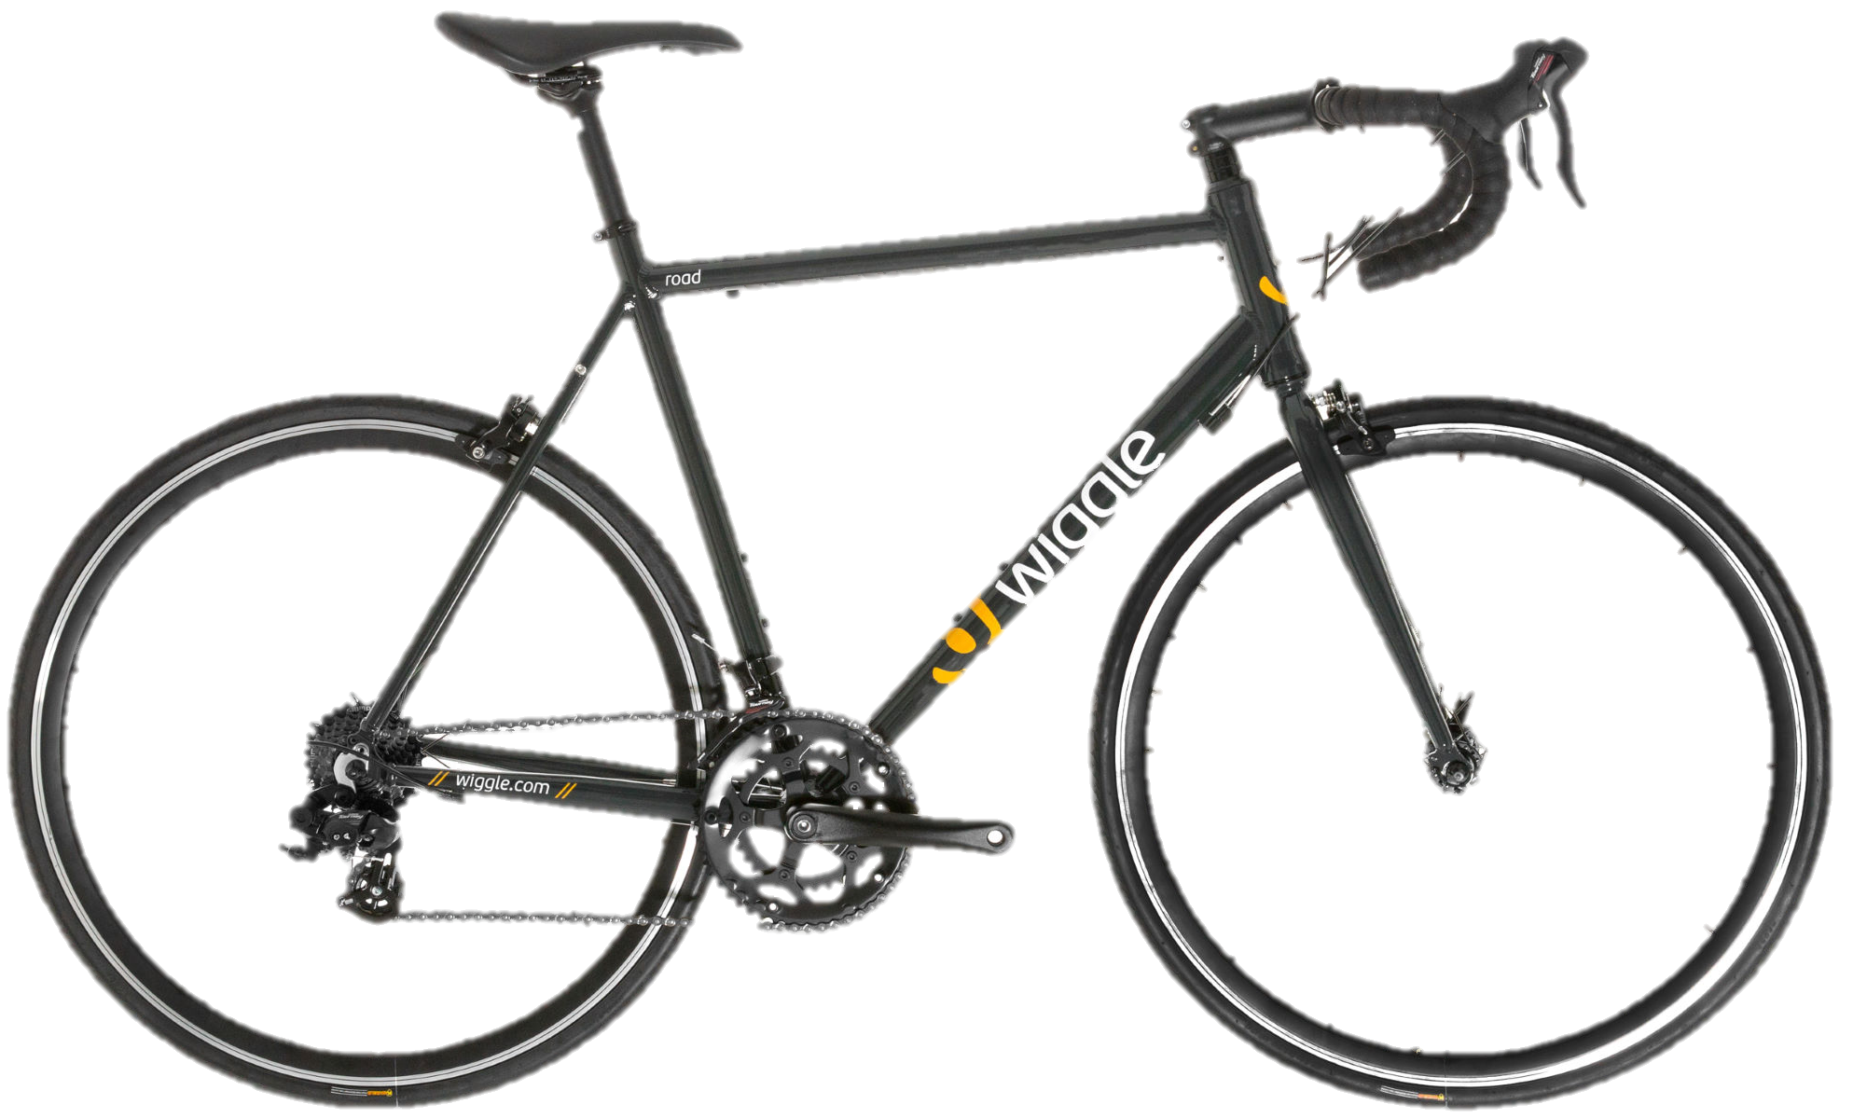
Help and References
Bike Speedometer Tutorial (http://lucidtronix.com/tutorials/13)
Ebay (For purchasing equipment)
RS-Components (For purchasing Hall effect sensor)
A Bike… (For obvious reasons)

Slide 7
Questions?

